Slide 1

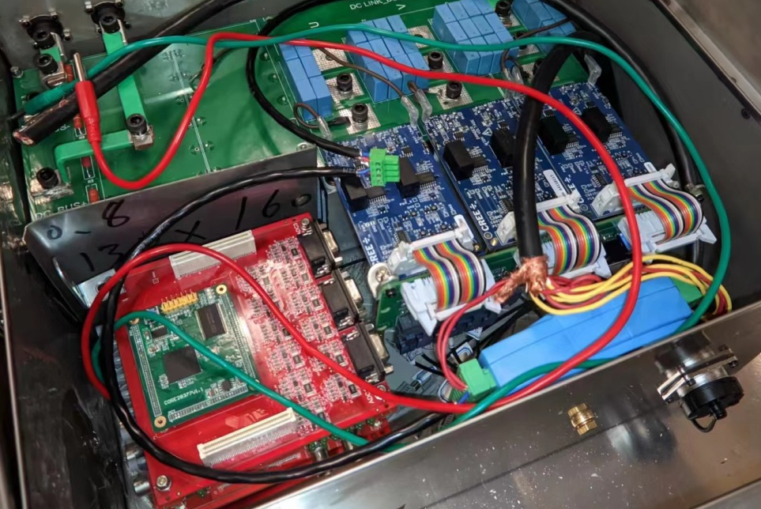
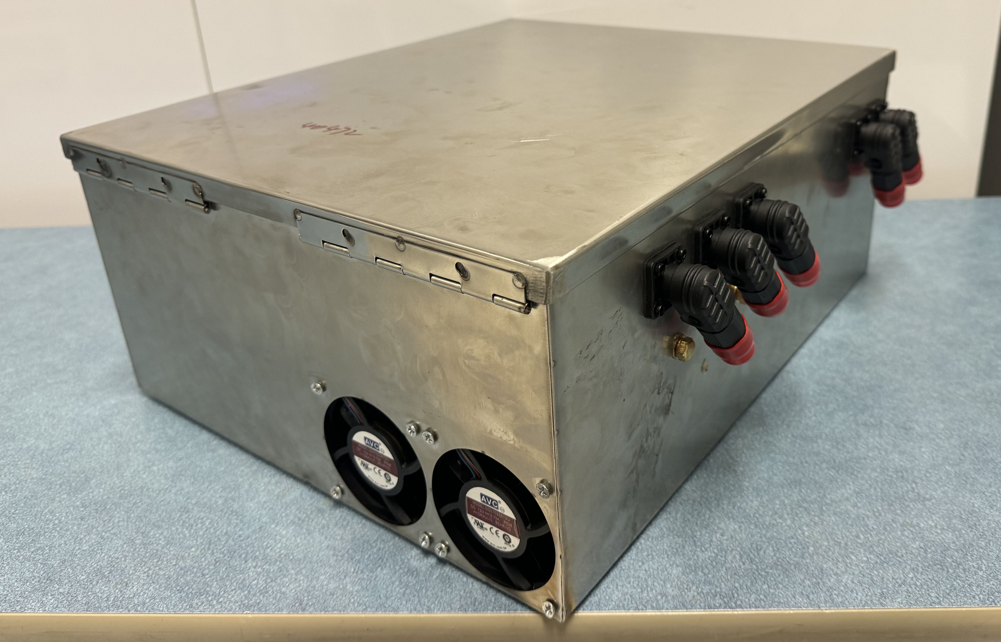
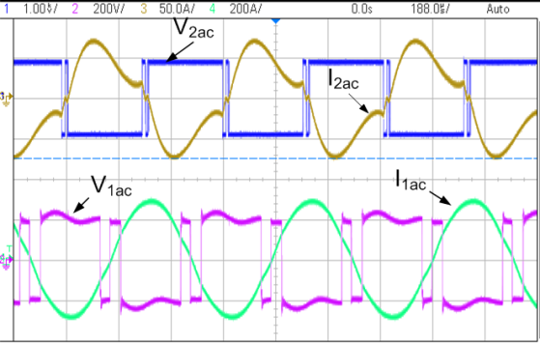
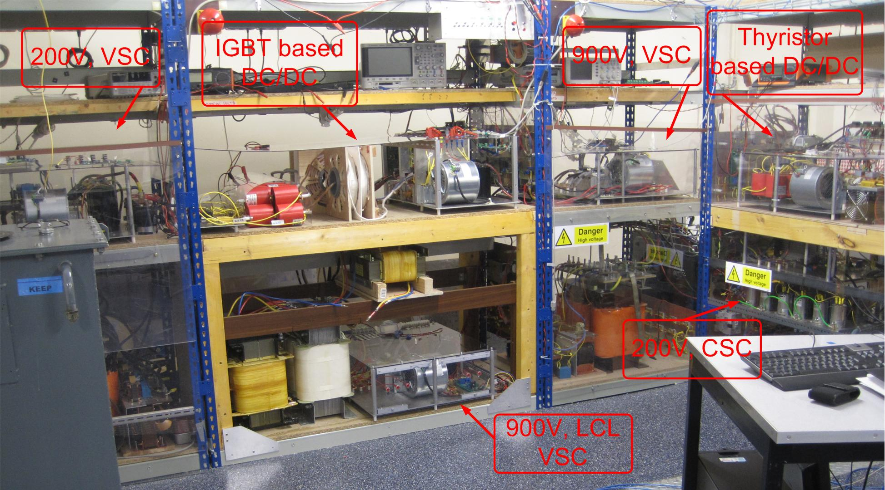
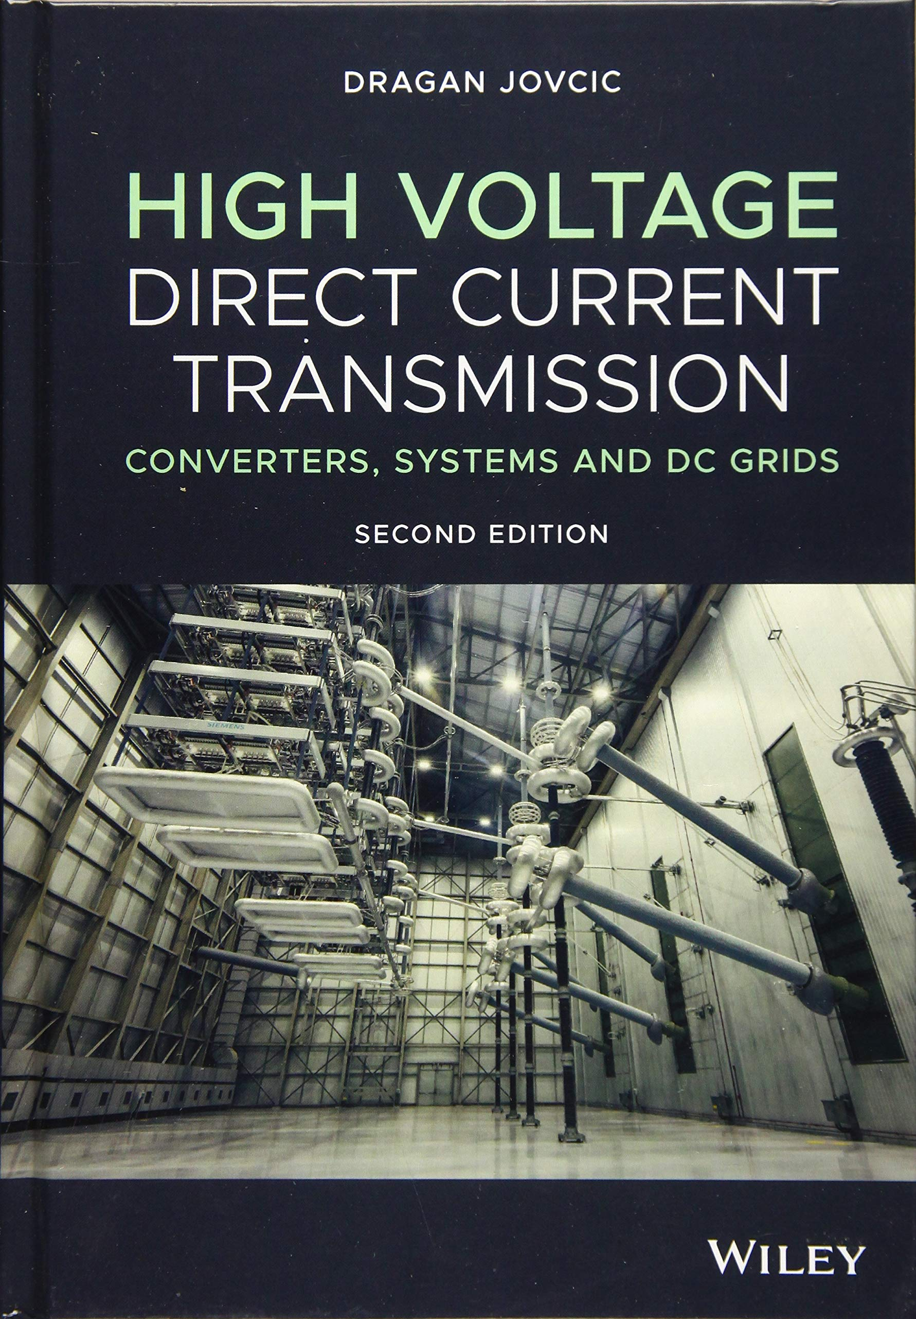
Aberdeen HVDC (High Voltage Direct Current)
Research Centre
Research themes:
  High Voltage DC Transmission,
  DC Transmission Grids,
  DC Circuit Breakers,
  Converter topologies, power electronics,
  Power system and converter modelling,
  Integration of renewable energy sources.
Research supported by
  EU/UK research councils,
  Scottish enterprise and
  Industry, (RTE, SSE, GE)
£5.5 Million external research funding since 2010
  PROMOTioN EU project (€39 million, 2016-2020) https://www.promotion-offshore.net/,
  MISSION EU project (€12 million, 2024-2027), https://euprojectmission.net/
  MowiLife EU project (€4 million, 2024-2027).
5-10 members including PhD students and research fellows
Substantial laboratory for demonstration of DC systems
(eVTOL) aircraft inverter prototype
(MMC) Modular Multilevel Converter
DC/DC converter responses
HVDC research center laboratory
Dragan Jovcic, d.jovcic@abdn.ac.uk
Xin Yuan, xin.yuan@abdn.ac.uk
Ai Jamshidifar, ajamshidifar@abdn.ac.uk

